Slide 1

STA321 分布式存储与并行计算
Project
12212824 12212813
李天宇 田文涛
2024.12.24

Slide 2
Part 1
问题描述

Slide 3

问题描述
对于数据库中提供的委托记录表和成交记录表，判断主动单方向，界定小单、中单、大单、超大单成交量与成交金额，计算主力流入、主力流出和主力净流入。
难点：需要根据成交记录表买方与卖方委托序列号，在委托记录表读取两委托时间并进行比较，以判断主动单方向（记录表数据庞大，直接使用map-join或reduce-join计算耗时太大）；合并相同索引主动单与分类（超大单/大单/中单/小单）。
Department of Statistics and Data Science

Slide 4
Part 2
任务理解

Slide 5
任务理解
使用HDFS + MapReduce的方式将委托记录表和交易记录表提炼为目标输出表格，对于给定股票计算每个时间窗口的对应数据：
字段名 | 含义 | 字段名 | 含义
TIMEWINDOW | 时间窗口开始时刻 | LARGE_SOLD_QUANTITY | 大卖单成交量
MAIN_NET_INFLOW | 主力净流入 | LARGE_SOLD_AMOUNT | 大卖单成交金额
MAIN_INFLOW | 主力流入 | MEDIUM_PURCHASED_QUANTITY | 中买单成交量
MAIN_OUTFLOW | 主力流出 | MEDIUM_PURCHASED_AMOUNT | 中买单成交金额
SUPER_LARGE_PURCHASED_QUANTITY | 超大买单成交量 | MEDIUM_SOLD_QUANTITY | 中卖单成交量
SUPER_LARGE_PURCHASED_AMOUNT | 超大买单成交金额 | MEDIUM_SOLD_AMOUNT | 中卖单成交金额
SUPER_LARGE_SOLD_QUANTITY | 超大卖单成交量 | SMALL_PURCHASED_QUANTITY | 小买单成交量
SUPER_LARGE_SOLD_AMOUNT | 超大卖单成交金额 | SMALL_PURCHASED_AMOUNT | 小买单成交金额
LARGE_PURCHASED_QUANTITY | 大买单成交量 | SMALL_SOLD_QUANTITY | 小卖单成交量
LARGE_PURCHASED_AMOUNT | 大买单成交金额 | SMALL_SOLD_AMOUNT | 小卖单成交金额
Department of Statistics and Data Science

Slide 6
任务理解
§主动单方向（买单/买单）
委托记录表
TransactTime
ApplSeqNum
(ApplSeqNum == BidApplSeqNum ||
ApplSeqNum == OfferApplSeqNum)
direction = (bidTransactTime > offerTransactTime) ? "BUY" : "SELL";
交易记录表
BidApplSeqNum
OfferAppleSeqNum
ExecType
ExecType == F
Department of Statistics and Data Science

Slide 7
任务理解
§TIMEWINDOW
需先根据时间窗口长短和早上/下午开盘时间算出各时间窗口开始时刻
交易记录表
TradeTime
ExecType
输出表
TIMEWINDOW
ExecType == F
根据tradeTime确定TIMEWINDOW
Department of Statistics and Data Science

Slide 8
Part 3
实现流程

Slide 9
实现流程
委托记录表
Mapper1
中间表
输出表
交易记录表
Mapper2
Reducer
Department of Statistics and Data Science

Slide 10
具体实现
§Map阶段
给定输入参数：SecurityID，timeWindow
中间表
TIMEWINDOW 主键
委托记录： 包含第7 9 10 11 12列
交易记录表
ApplSeqNum (7)
SecurityID (8)
OrderQty (9)
BidApplSeqNum (10)
OfferApplSeqNum (11)
Price (12)
ExecType (14)
TradeTime (15)
(Filtered)
ExecType == F
private String createTimeKey(String tradeTime){
......
String TIMEWWINDOW = String.format("%d%02d%02d%02d%02d00000 to %d%02d%02d%02d%02d00000",
year, month, day, finalStartHour, finalStartMinute,
year, month, day, finalEndHour, finalEndMinute);
return TIMEWINDOW;
}
Department of Statistics and Data Science

Slide 11

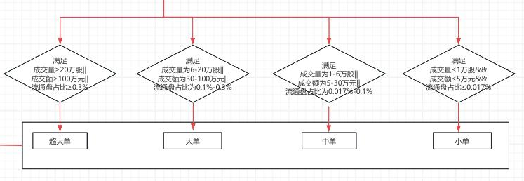
具体实现
§Reduce阶段
中间表
TIMEWINDOW 主键
ApplSeqNum (7)
OrderQty (9)
BidApplSeqNum (10)
OfferApplSeqNum (11)
Price (12)
TradeTime (15)
输出表
TIMEWINDOW
MAIN_NET_INFLOW
MAIN_INFLOW
MAIN_OUTFLOW
SUPER_LARGE_PURCHASED_QUANTITY
SUPER_LARGE_PURCHASED_AMOUNT
SUPER_LARGE_SOLD_QUANTITY
······
direction = (bidTransactTime > offerTransactTime) ? "BUY" : "SELL";
根据金额和交易量分类
分类将交易记录写入相应hashMap:
HashMap<String, String> buyMap;
HashMap<String, String> sellMap;
<序列号, “总交易量 总金额”>
若HashMap已存在相应委托单号,则合并相同BidApplSeqNum/Offer~ 的Qty
Department of Statistics and Data Science

Slide 12
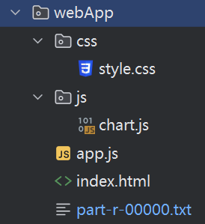
具体实现
§可视化阶段：
采用chart.js包，将输出文件与html文件置于一个目录。详见http://localhost:63342/project/src/main/java/webApp/index.html?_ijt=jheajtiojeqs9e6f6qb5tv17at&_ij_reload=RELOAD_ON_SAVE
Department of Statistics and Data Science

Slide 13
Thanks for Listening

